Slide 1
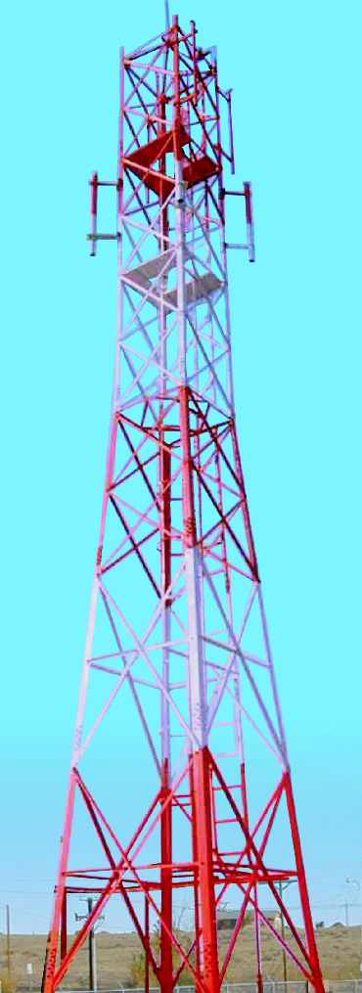
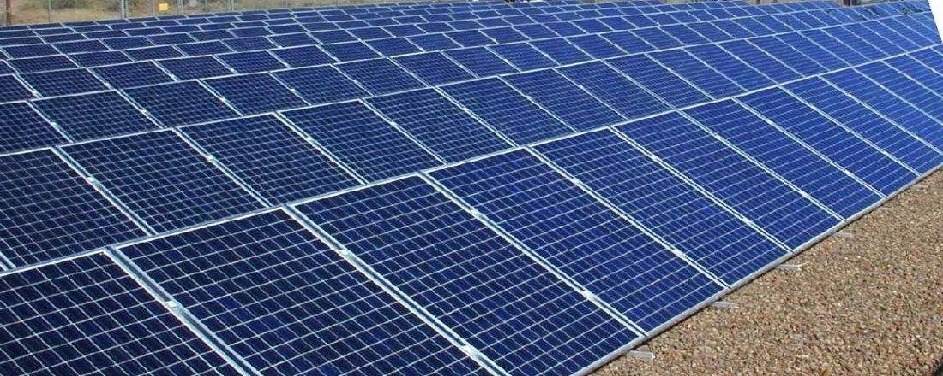
SOLAR POWER SOLUTION FOR TELECOM APPLICATIONS
TECHNICAL OVERVIEW
BY
DIAMOND GREEN ENERGY CORPORATION

Slide 2

OVERVIEW
Telecommunications and security applications are typically located far from the reach of grid lines.
If grid lines are available they are not so dependable , and telecom companies have to face problems of erratic power supply.
The present alternative with the companies is use of Generator sets at each tower. These are backed up with inverter and battery bank.
With the increase in cost of diesel and pilferage of diesel, companies are forced to find a solution to overcome this problem.
The solution lies in installation of SOLAR POWERED PLANTS.

Slide 3
Advantages
Availability of clean power , which ensures effective operation and performance of BTS stations.
Reduction of operational cost. And Carbon emissions.
Negligible maintenance.
Noise free.
Independent of other modes of electrical infrastructure.

Slide 4
System Configuration
The Solar systems are designed to provide either DC or AC output power depending on type of load. Most telecom systems operate on 12/24/48v DC. Typical system sizes are 2,3,4 & 7 kw.
The system provides sufficient energy for the specific applications and store the energy in maintenance free batteries. Depending on specific requirements, the system can be configured to store and provide Solar energy up to 7 cloudy – non sunshine days.

Slide 5
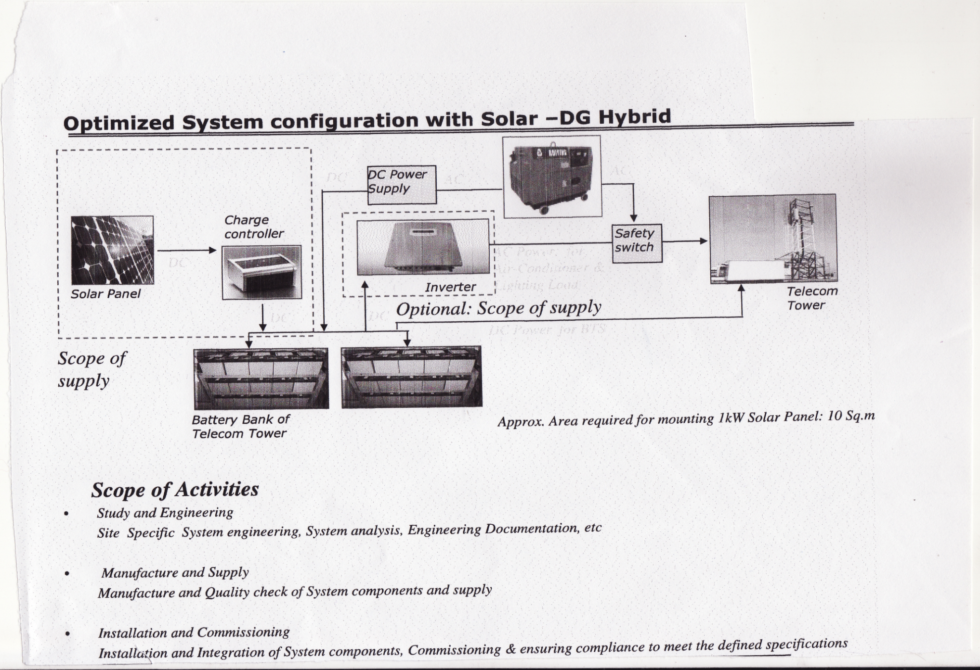

Slide 6
Scope Of Supply
Solar panel to required sizing.
Module mounting structure
Solar charge controller
Related Cable assembly up to connection to battery bank
Junction box with safety switch.
Installation and Commissioning
Inverter for Dc to Ac Conversion For Ac Load and related cabling. OPTIONAL AT EXTRA COST.
Web based Remote sensing software at Extra cost.

Slide 7
Typical power consumption information of cell tower
 | SITE TYPE | BTS | LIGHTING LOAD | AIRCONDITIONER LOAD | TOTAL LOAD
 |  | KW | WATT | KW | KW
1 | OUTDOOR | 1.2, 48 V DC | 300, 220 V AC | 0 | 1.5
2 | INDOOR | 0 | 0 | 2.0, 220 V AC | 2
 |  |  | TOTAL LOAD OF BTS, LIGHTING AND AC |  | 3.5

Slide 8
LOAD ANALYSIS FOR SYSTEM SIZING
BTS LOAD
For 12 Hrs during day, the average BTS load is 1.2KW at 48V DC…..is 25AH x 12=300AH
For 12 Hrs during night, the average is approximately 0.7KW at 48V DC…….is 15AH x 12=180AH
Total ampere/hr required for BTS =480AH
AIR CONDITIONER LOAD
Power rating of air conditioner 2KW at 230V/50hz
Considering power factor of one and duty cycle at 30% for air conditioner, the AH required at 48V DC is 300AH.
THE CUMULATIVE AH REQUIRED FOR BATTERY BANK PER DAY CONSIDERING ALLOWANCE FOR SYSTEM LOSSES ETC.=800AH

Slide 9
Considering 75% depth of discharge, below is the percentage of battery bank which can be charged by solar. Where the solar is charging part capacity of battery bank, the DG set should be run to charge the balance AH
Solar array size / Average power generation in AH per day | BATTERY BANK SIZE
 | 300AH | 600AH | 900AH | 1200AH
1KW (115AH @ 48V DC) | 50% | 25% | 20% | 15%
2KW (230AH @ 48V DC) | 100% | 50% | 35% | 25%
3KW (345AH @ 48V DC) | BATT.BANK INSUFFICIENT | 75% | 50% | 40%
4KW (460AH @ 48V DC) | BATT.BANK INSUFFICIENT | 100% | 70% | 50%
5KW (572AH @ 48V DC) | BATT.BANK INSUFFICIENT | BATT.BANK INSUFFICIENT | 85% | 65%
6KW (687AH @ 48V DC) | BATT.BANK INSUFFICIENT | BATT.BANK INSUUFICIENT | 100% | 75%

Slide 10
DG RUN TIME REQUIRED TO TOP THE BATTERY BANK ( 15 KVA DG SET CHARGES THE BATTERY AT 50 AH)
SOLAR ARRAY SIZE/AVERAGE POWER GENERATION IN AH/DAY | BATTERY BANK SIZE
 | 300 AH | 600 AH | 900 AH | 1200 AH
IKW ( 115AH @ 48V DC) | 115 AH/ 2 HRS OF DG | 337 AH/7 HRS OF DG | 540 AH/ 11 HRS OF DG | 765 AH /15 HRS OF DG
2KW ( 230 AH@48 V DC) | 0AH/0 HRS OF DG | 225 AH/4.5 HRS OF DG | 438 AH/9 HRS OF DG | 675 AH /13.5 HRS OF DG
3KW (345AH @ 48V DC) |  | 112 AH/2 HRS OF DG | 330 AH/6.5 HRS OF DG | 540 AH/11 HRS OF DG
4KW (460AH @ 48V DC) |  | 0AH/0HRS OF DG | 200 AH/4HRS OF DG | 450 AH/9 HRS OF DG
5KW (572AH @ 48V DC) |  |  | 100 AH /2 HRS OF DG | 315 AH/6 HRS OF DG
6KW (687AH @ 48V DC) |  |  | 0 AH/ 0 HRS OF DG | 225 AH /4.5 HRS OF DG

Slide 11
DG RUN TIME REQUIRED FOR 24 HRS OPERATION OF BTS AND AIRCONDITIONER LOAD
SOLAR ARRAY SIZE/AVERAGE POWER GENERATION IN AH/DAY | BATTERY BANK SIZE
 | 300 AH | 600 AH | 900 AH | 1100 AH
IKW ( 115AH @ 48V DC) | 685 AH/14 HRS OF DG | 685 AH/14 HRS DG | 685 AH/14 HRS DG | 685 AH/14 HRS DG
2KW ( 230 AH@48 V DC) | 575 AH/11.5 HRS OF DG | 575 AH/11.5 HRS OF DG | 575 AH/11.5 HRS OF DG | 575 AH/11.5 HRS OF DG
3KW (345AH @ 48V DC) |  | 455 AH/9 HRS OF DG | 455 AH/9 HRS OF DG | 455 AH/9 HRS OF DG
4KW (460AH @ 48V DC) |  | 340 AH /7 HRS OF DG | 340 AH /7 HRS OF DG | 340 AH /7 HRS OF DG
5KW (572AH @ 48V DC) |  |  | 228 AH/4.5 HRS OF DG | 228 AH/4.5 HRS OF DG
6KW (687AH @ 48V DC) |  |  | 0 AH/ 2 HRS OF DG | 110 AH/2 HRS OF DG
7KW (800AH @ 48V DC) |  |  |  | 0 AH/0 HRS OF DG

Slide 12
INFERENCE
Cumulative load AH per day , including BTS and Air conditioner is 800 AH.
For DG to power 100 % load without solar system 15 KVA DG should run for minimum 16 Hrs a day.
A 7 Kw solar system with 1100 AH battery bank is required to run the total load for 24 Hrs , DG set required to support non sunshine days.
Optimal solar-DG hybrid system
A 4 Kw system with 900 AH battery bank needs only 4 hrs of DG run to take care of total load .
4Kw solar system will account to saving of 12 Hrs of DG run , saving 30 liters of diesel per day amounting to Rs 1500 per day , 5.47 lakh per year.
Hence the payback on a 4 Kw solar power system is approx. 1.25 years.

Slide 13
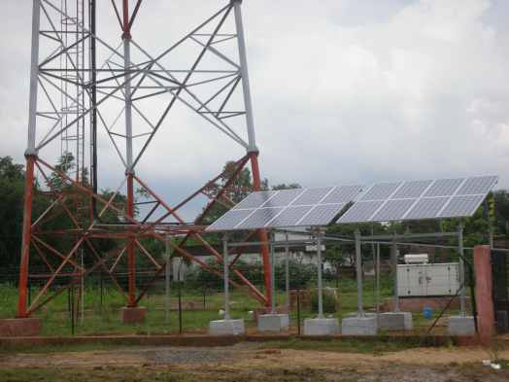
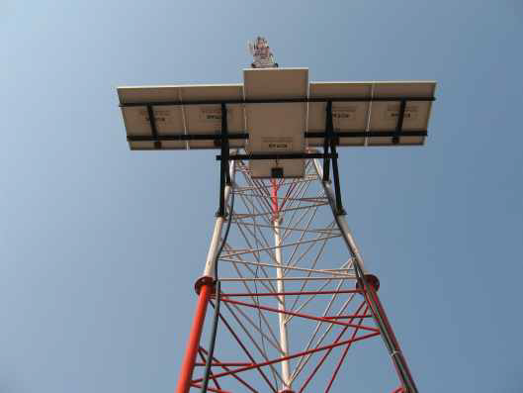
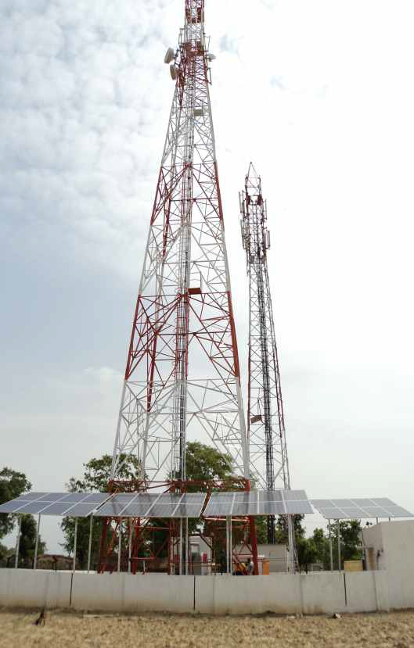
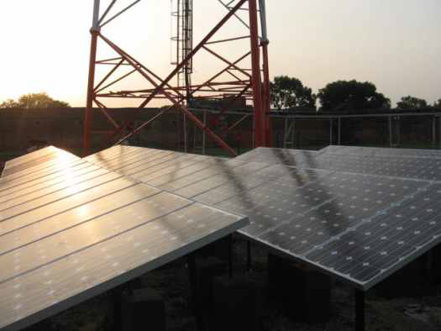
OUR INSTALLATIONS IN BIHARRAR

Slide 14
About Us
Diamond Green Energy Corporation works as a Solar System Integrator in association with a Channel Partner of MNRE , i.e., Kotak Urja Pvt Ltd, Bangalore.
It is a sole proprietorship concern. The owner is a Techno commercial personality with experience of more than 27 years, out of which 11 years have been in Solar line.
He has vast experience of Solar installations in Africa namely in Nigeria, Kenya, and South Africa.
Presently He is working in Bihar and Jharkhand for electrification of villages where Grid lines have not been provided by Government so far. More than 400 villages have been electrified in the last three years.

Slide 15
THANK YOU
DIAMOND GREEN ENERGY CORPORATION
#404, GH16, SECTOR 20, PANCHKULA, HARYANA
REGD OFFICE; OLD THANA ROAD, HASPURA , AURANGABAD, BIHAR.
BRANCH OFFICE ; #504, EMARAT FIRDAUS,EXHIBITION ROAD , PATNA , BIHAR
CONTACT; 91-9815067680, 91-8757498772,
www,diamondgreenenergy.in

